Slide 1



Real Time Face
Detection and Recognition
By
Navnath Auti (05)
Sahil Nazare (46)
Binitdev Pandey (48)
Adnan Shaikh (68)
UNDER THE GUIDANCE
OF
PROF. HEMALATA GOSAVI
OCTOBER 12, 2022

Slide 2

INDEX
Introduction
Literature Review
Algorithms
Design Details
System Specifications
Summary
References

Slide 3


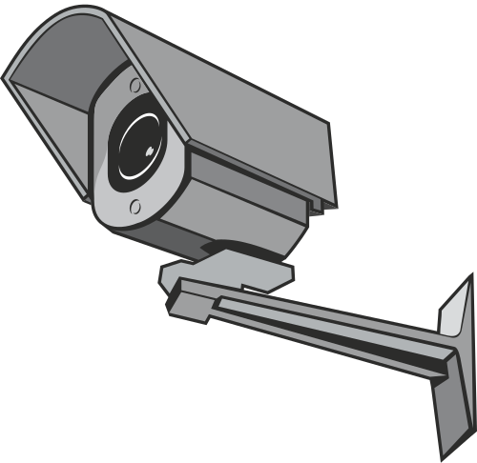
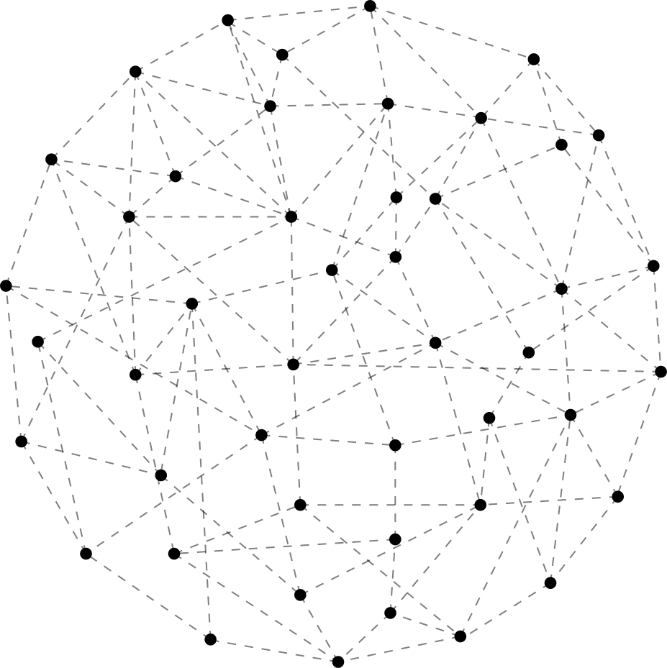
BACK TO INDEX PAGE
Introduction
MOTIVAVTION
AIM
BRIEF STEPS

Slide 4
BACK TO INDEX PAGE
Literature Review
Paper Name | Author Name | Year | Publication | Remark
A Real-Time Framework for Human Face Detection and Recognition in CCTV Images [2] | Rehmat Ullah , Hassan Hayat, Afsah Abid Siddiqui, Jebran Khan, Farman Ullah | 2022 | Hindawi | A CCTV based face recognition system which recognize single face from Image using PCA, CNN and KNN It requires average of 30 images for each face before classifying accurately
Face Recognition based Surveillance System Using FaceNet and MTCNN on Jetson TX2 [1] | Edwin Jose, Greeshma M, Mithun Haridas T. P | 2019 | IEEE | Face detection and recognition of human faces using embedded graphic card Jetson TX2 in IP camera Models used by the authors are MTCNN and FaceNet

Slide 5
BACK TO INDEX PAGE
Literature Review
Paper Name | Author Name | Year | Publication | Remark
Joint Face Detection and Alignment Using Multitask Cascaded Convolutional Networks [4] | Kaipeng Zhang, Zhanpeng Zhang, Zhifeng Li, Senior Member, IEEE, and Yu Qiao, Senior Member, IEEE | 2016 | IEEE | Deep learning algorithm for face detection on different alignment of face Multitask-Cascaded Convolutional Networks is enhanced version of Cascade Classifier
FaceNet: A unified embedding for face recognition and clustering [5] | F. Schroff, D. Kalenichenko and J. Philbin | 2015 | IEEE | Learns an embedding into an Euclidean space for face verification Based on two deep network architectures to make this model.

Slide 6
BACK TO INDEX PAGE
Literature Review
Paper Name | Author Name | Year | Publication | Remark
Robust Real-Time Face Detection [3] | Paul Viola, Michael J. Jones | 2003 | Kluwer Academic Publishers | Cascade Classifier Haar-like features Integral image Best suited for real time face detection

Slide 7


BACK TO INDEX PAGE
Algorithms
Cascade Classifier
MTCNN
FaceNet

Slide 8

BACK TO INDEX PAGE
Design Details
Extraction of frames from Ip camera video using OpenCV
Extraction of faces from frames using Haar Cascade Classifier
Recognition of extracted faces from frames using Facenet
If face matched with any faces in face repository, then storing it in Index DB with corresponding frame time and location of camera using Desktop Application

Slide 9
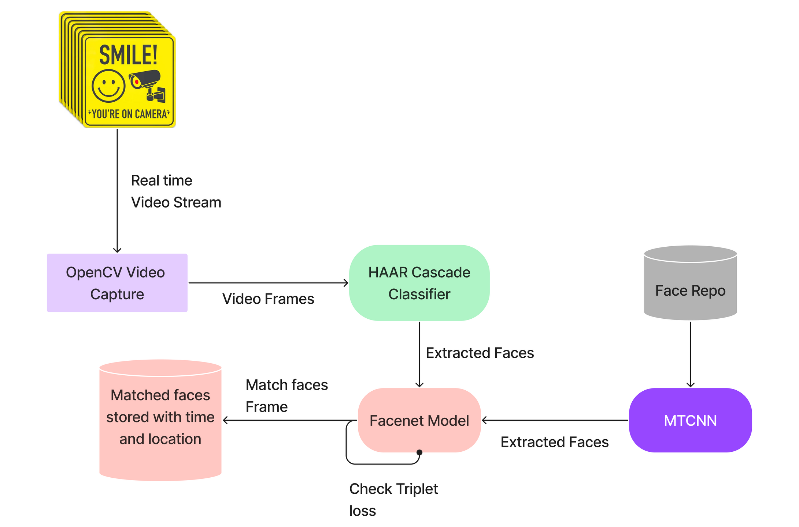

BACK TO INDEX PAGE
Flow Diagram

Slide 10

BACK TO INDEX PAGE
System Specifications
Hardware
Software
RAM: Minimum 4GB
CPU: Intel Core i3 or higher
Hard Drive: 40GB free space
IP Camera
Graphic Card (Optional)
TensorFlow
NumPy
OpenCV
Python IDE
Kivy (Python open source Framework)

Slide 11

BACK TO INDEX PAGE
Summary
This project will demonstrate a system for face recognition from surveillance video and it will be robust to changes in illumination, scale, facial expression and reasonably robust to occlusions and changes in pose.

Slide 12

BACK TO INDEX PAGE
References
[1] Edwin Jose, Greeshma M, Mithun Haridas T. P, “Face Recognition based Surveillance System Using FaceNet and MTCNN on Jetson TX2” 2019 IEEE 5th International Conference on Advanced Computing & Communication Systems (ICACCS).
[2] Rehmat Ullah , Hassan Hayat, Afsah Abid Siddiqui, Jebran Khan, Farman Ullah, “A Real-Time Framework for Human Face Detection and Recognition in CCTV Images” 2022 Hindawi Mathematical Problems in Engineering.
[3] Paul Viola, Michael J. Jones, “Robust Real-Time Face Detection” July 11, 2003 Kluwer Academic Publishers
International Journal of Computer Vision.
[4] Kaipeng Zhang, Zhanpeng Zhang, Zhifeng Li, Senior Member, IEEE, and Yu Qiao, Senior Member, IEEE, “Joint Face Detection and Alignment Using Multitask Cascaded Convolutional Networks” October 10, 2016 IEEE SIGNAL PROCESSING LETTERS, VOL. 23
[5] F. Schroff, D. Kalenichenko and J. Philbin, "FaceNet: A unified embedding for face recognition and clustering," 2015 IEEE Conference on Computer Vision and Pattern Recognition (CVPR), Boston, MA, 2015 IEEE, pp. 815-823. 2
[6] Y. Sun, X. Wang, and X. Tang. Deeply learned face representations are sparse, selective, and robust. CoRR, abs/1412.1265, 2014 IEEE. 1, 2, 5, 8
[7] Y. Taigman, M. Yang, M. Ranzato, and L. Wolf. Deepface: Closing the gap to human-level performance in face verification. In IEEE Conf. on CVPR, 2014. 1, 2, 5, 8

Slide 13

Thank
you!

